Slide 1
Mental Wellness Sentiment Analysis
Description of the problem
Provide starting point for the therapist with new clients.
Qualitative analysis experiences improvement
Wanted to estimate person mental wellness based on text.
Approach
Scrape labeled data from webpages
Organizes the data, then split the data into training set and validation set.
Feed the training data set into a RNN (Recurrent Neural Network) model, use validation data set to validate the accuracy of the model.
Tuning the hyperparamters.
Participant: Jiaan Nie, 200327281

Slide 2
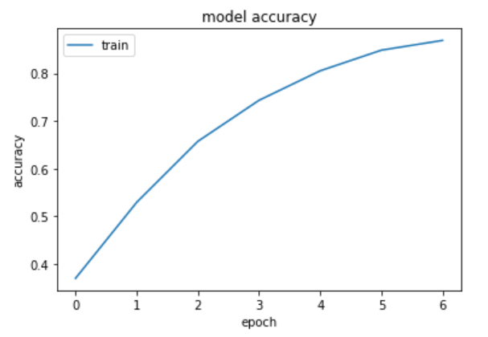
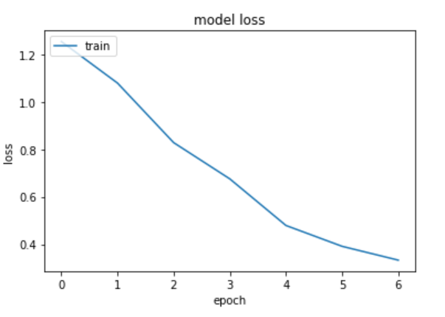
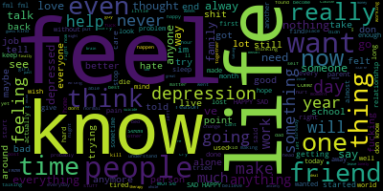
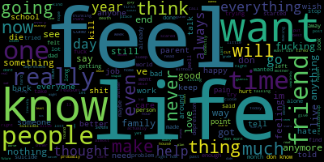

Result

